Slide 1
Web Application for Idea Management Teck Week 2019
MinJie Qiu, Yuxiang Wang (Hua Zhang)

Slide 2
Why
How to make our ideas down to the ground?
Idea Collection
Idea Repository
Idea Popularization

Slide 3
What

Slide 4


How

Slide 5
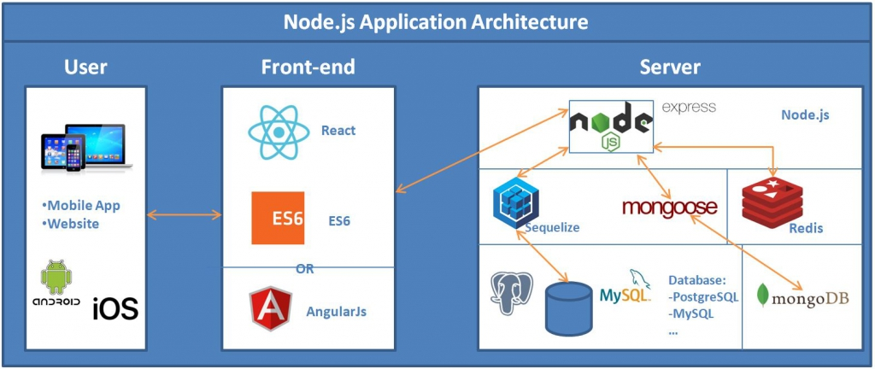
How

Slide 6

How
React
Faster rendering with virtual DOM
Node/Express
Asynchronous with non-blocking IO
MongoDB
Easy to evolve data structure with flexibility of schema

Slide 7
How

Slide 8
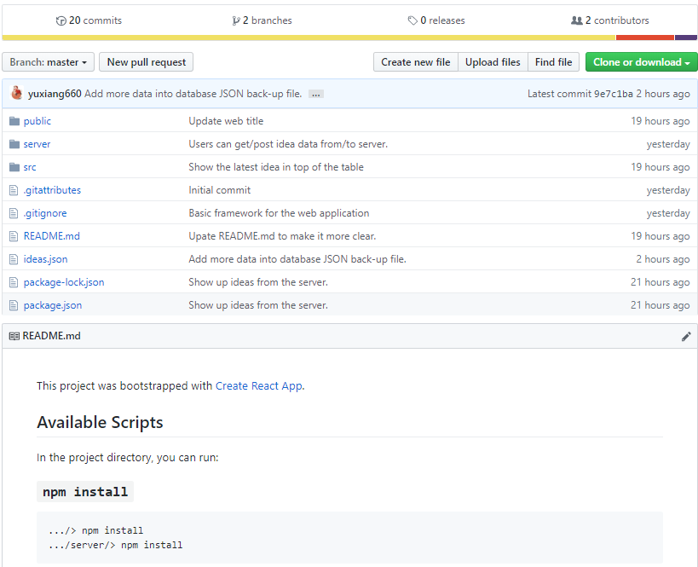
How
Github: https://github.com/yuxiang660/web-application-for-idea-collection

Slide 9
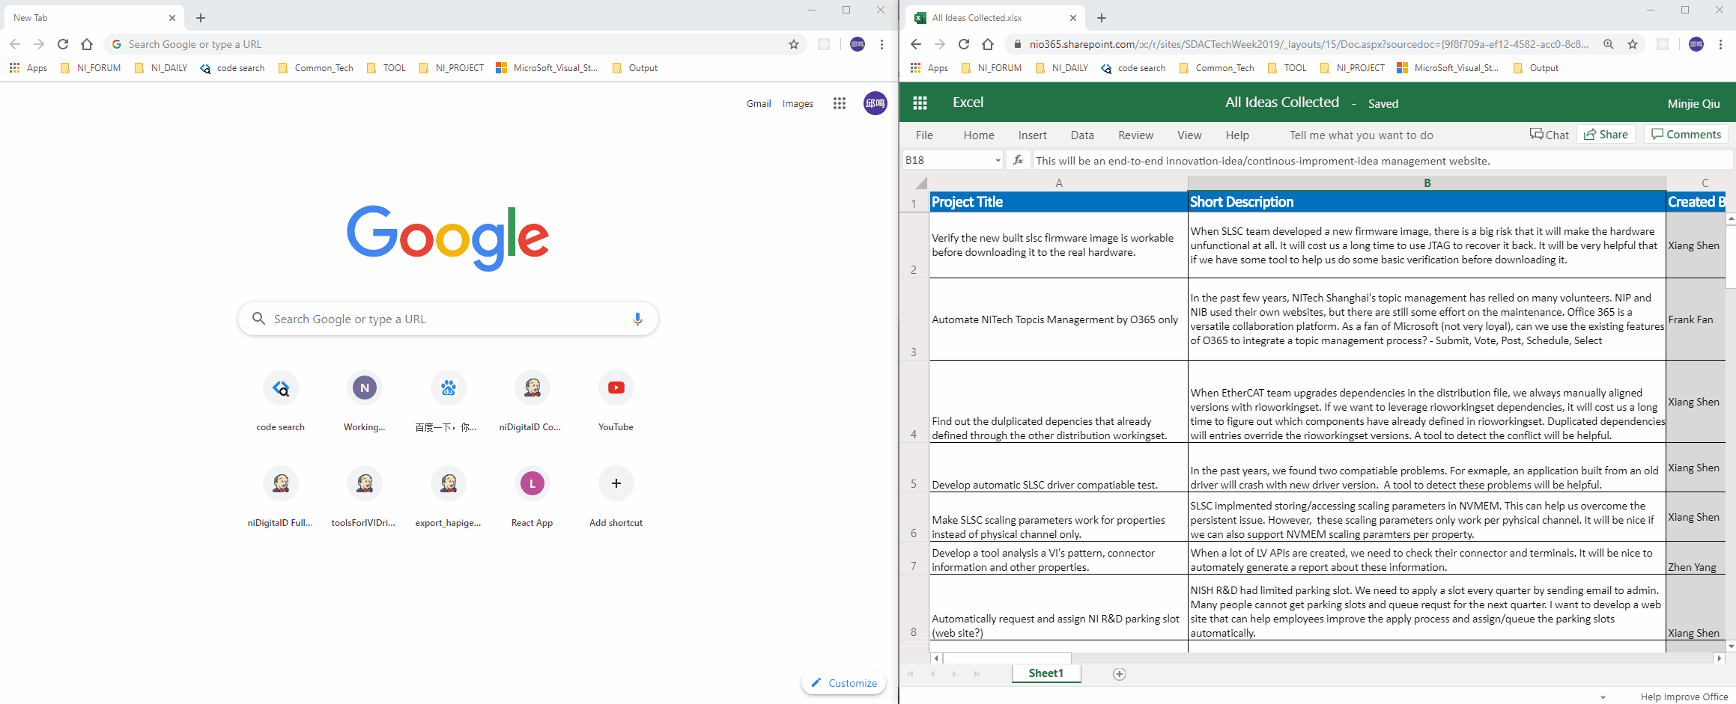
Demo

